Slide 1
Unix System Overview (Programmer’s Perspective)
Chien-Chung Shen
CIS/UD
cshen@udel.edu

Slide 2
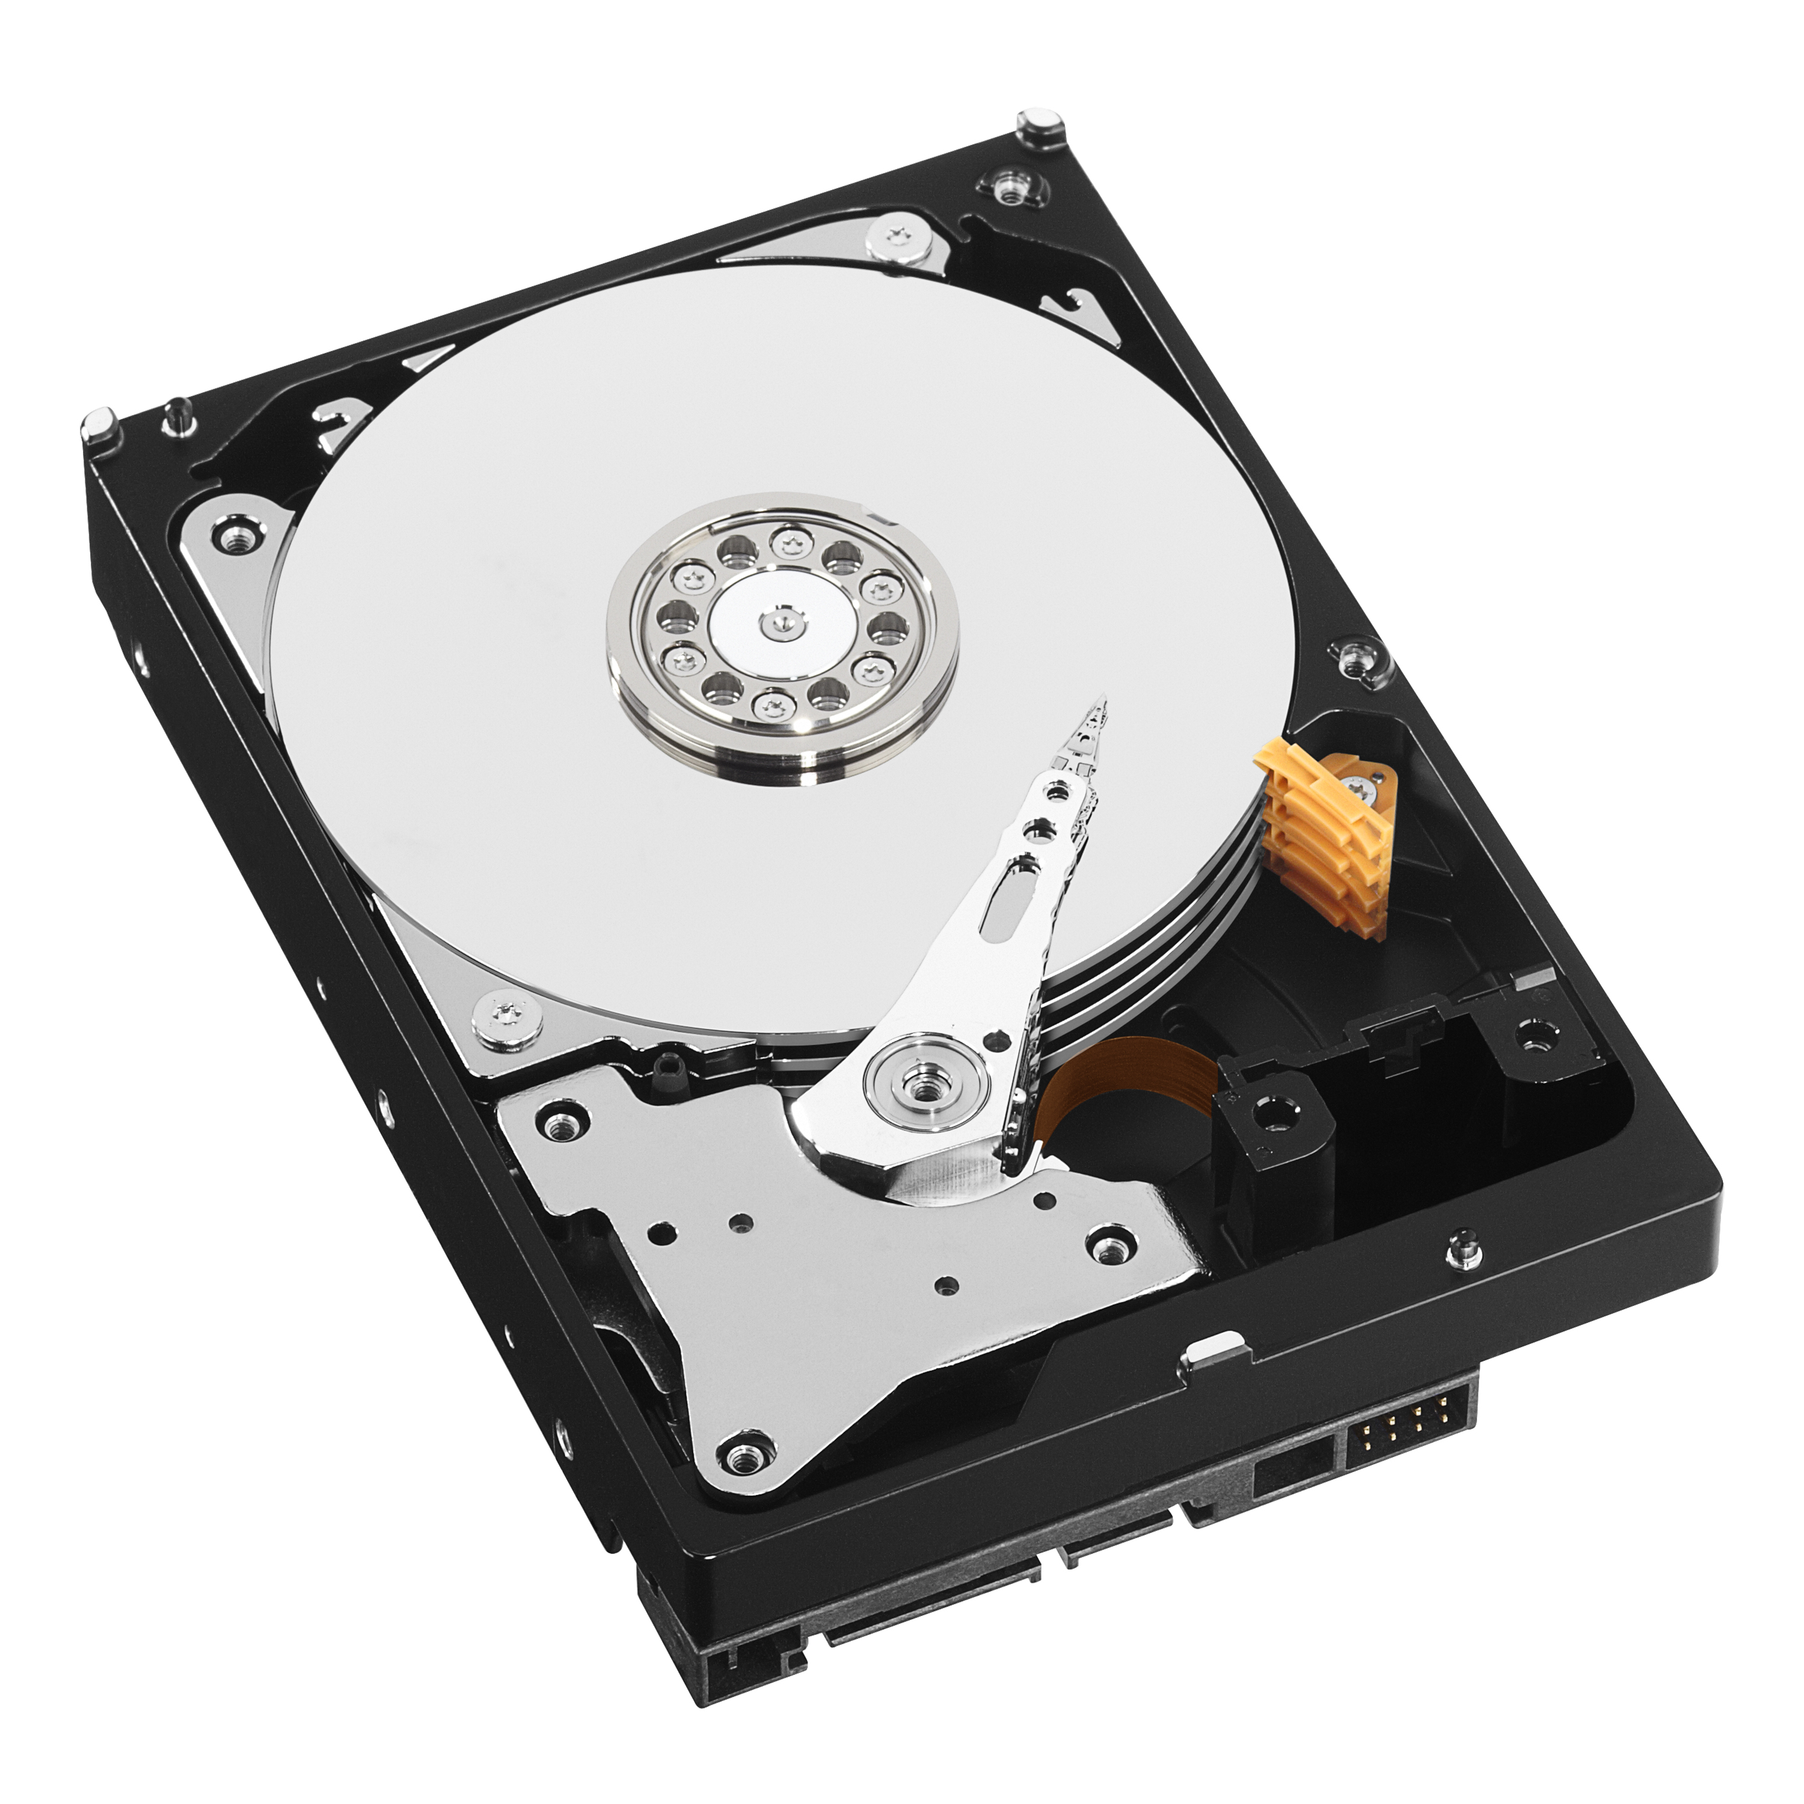
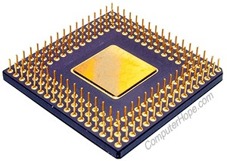
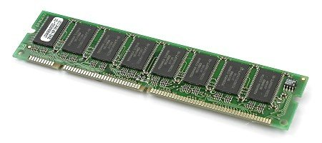

Introduction
Given the hardware, operating systems provide services for programs they run
typical services
execute a new program
open/read a file
allocate memory
obtain current time of day
etc.
How?
system calls and kernel implementations
Introduce Unix from a programmer’s perspective
(Liskov's Turning Award lecture: The Power of Abstraction)

Slide 3
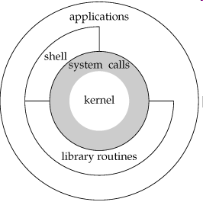
Unix Architecture
OS is the software that
controls the hardware resources of the computer
provides an environment under which programs can run
A.k.a. kernel (residing at the core)
System calls: a layer of
software providing the
interface to the kernel
Library functions, shells,
application programs, etc.

Slide 4
Shells
After login, a shell starts running
A command-line interpreter that reads user input and executes commands
input from terminal: interactive shell
input from file: shell script
On cisc361.acad (Ubuntu on Intel CPU)
Name Path
Bourne shell /usr/bin/sh
Bourne-again shell /usr/local/gnu/bin/bash
C shell /usr/bin/csh
Korn shell /usr/bin/ksh
TENEX C shell /usr/bin/tcsh
$ finger -p cshen

Slide 5
Files and Directories
Unix ﬁle system is a hierarchical arrangement of directories and ﬁles starting from the root “/”
A directory is a ﬁle that contains “directory entries” [files or (sub)-directories]
Each directory entry has [filename and attributes]: size, type, owner, permissions, etc. – obtained via system calls stat()/fstat()
Names in a directory are called filename
. and .. in each directory whenever it is created
Slash (/) separates filenames to form pathname
Relative and absolute pathnames
relative to the current directory
begin with “/”
Home and (current) working directory

Slide 6
List All Filenames in a Directory
Fig. 1.3 of Stevens’ book
// function prototypes for opendir(), etc.
#include <dirent.h>
int
main(int argc, char *argv[])
{
DIR *dp;
struct dirent *dirp;
if (argc != 2)
err_quit("usage: ls directory_name");
if ((dp = opendir(argv[1])) == NULL)
err_sys("can’t open %s", argv[1]);
while ((dirp = readdir(dp)) != NULL)
printf("%s\n", dirp->d_name);
closedir(dp);
exit(0);
}
What is this program?
bare-bone implementation of the ls(1) command
$ man 1 ls
$ man –s 1 ls
opendir(), readdir(), and closedir()
are standard C library functions

Slide 7
Input and Output
When opening an existing ﬁle or creating a new ﬁle, kernel returns a ﬁle descriptor (a non-negative integer) for reading or writing the ﬁle
When executing a new program, shell opens three (3) standard file descriptors: stdin, stdout, stderr
Normally, they are all connected to the “terminal”
Redirection:
ls > file.list
a.out < myInput > myOutput
STDIN_FILENO (0), STDOUT_FILENO (1), STDERR_FILENO (2) are defined in /usr/include/unistd.h and used via #include <unistd.h>
Figure 1.4 (end-of-file == ^D) – e.g., ./mycat > data
[read()& write()(unbuffered I/O) are system calls]
“Unbuffered” means each read or write invokes a system call in the kernel

Slide 8
Standard I/O
vs. unbuffered I/O
Standard I/O functions provide buffered interface to unbuffered I/O functions (read(), write(), etc.) to minimize the number of read and write calls
Can deal with lines of input, and not worry about finding optimal BUFFERSIZE value in Fig. 1.4 (mycat.c)
e.g., fgets() reads an entire line (terminated by \n)
#include <stdio.h>
printf()
Fig. 1.5 (getcputc.c) with getc() and putc()
starndard I/O constants, stdin, stdout, etc. are defined in stdio.h

Slide 9
Programs and Processes
Program: an executable file (e.g., a.out) residing on disk in a directory
A program is read into memory and is executed by the kernel as a result of one of seven (7) exec() system calls
Process: an executing instance of a program (task in Windows)
Every process has a unique identiﬁer called process ID (PID)
Fig. 1.6: hello.c (getpid())
What happened to the missing pids?

Slide 10
Process Control
Three primary functions: fork(),
exec(), waitpid()
Fig. 1.7
End-of-file (^D) causes fgets() to return a null pointer
What kind of program is Fig. 1.7?

Slide 11
Unix Process Management
fork is called once, but returns twice in two separate processes
Bring the new executable image into memory and start it running
Child
Parent
Set up context [priority and I/O] for new program that is about to be started (e.g., close some files, open others, reduce priority, etc.)
Parent
Wait for child process to terminate
Notes:
How is this used – typically, fork a process, child and parent are now both running the same program. One sets up the child program, and runs exec – becoming the new program
The parent, usually, waits for the child to finish

Slide 12
Error Handling
When an error occurs from executing a Unix system function, either -1 or null pointer is returned, and errno is set a value that tells why
File <errno.h> defines symbol errno and assumed constants (error constants are listed in errno(3) manual page)
Standard C library functions for printing error messages: strerror() and perror()
Fig. 1.8
Usefulness of argv[0] in
$ prog1 < input | prog2 | prog3 > output
(tell which of the 3 programs generates the error message)
What is argv[0]?
Rules of using errno
its value is never cleared by a routine if an error does not occur. Therefore, we should examine its value only when the return value from a function indicates that an error occurred
the value of errno is never set to 0 by any of the functions, and none of the constants defined in <errno.h> has a value of 0
Check Appendix B.2 for more error reporting functions

Slide 13
Signals
“Software interrupts” to notify events
ignore
default action: e.g., process terminates
“catching” signals via user-defined functions
Control-C, kill, kill()
Fig. 1.10

Slide 14
Time
Calendar time: number of seconds that have elapsed since midnight Coordinated Universal Time (UTC), January 1, 1970, not counting leap seconds: C type time_t
e.g., used to record when a file was last modified
$ date +%s
Process (CPU) time: measure the CPU usage in clock ticks (50, 60, or 100 ticks per second, found out via sysconf()): C type clock_t
The time(1) command
$ cd /usr/include
$ time grep _POSIX_SOURCE */*.h > /dev/null

Slide 15
Why System Calls Look Like Function Calls?
You may wonder why a call to a system call, such as open() or read(), looks exactly like a typical function call in C; that is, if it looks just like a function call, how does the system know it’s a system call, and do all the right stuff?

Slide 16
System Calls and Library Functions
“All operating systems provide service points through which programs request services from the kernel. All implementations of the UNIX System provide a well-defined, limited number of entry points directly into the kernel called system calls.
“The system call interface has always been documented in Section 2 of the UNIX Programmer’s Manual. Its definition is in the C language, regardless of the actual implementation technique used on any given system to invoke a system call. This differs from many older operating systems, which traditionally defined the kernel entry points in the assembler language of the machine.”
“man page” on Wikipedia

Slide 18
System Calls and Library Functions
“The technique used on UNIX systems is for each system call to have a function of the same name in the standard C library. The user process calls this function, using the standard C calling sequence. This function then invokes the appropriate kernel service, using whatever technique is required on the system. For example, the function may put one or more of the C arguments into general registers and then execute some machine instruction [trap] that generates a software interrupt in the kernel. For our purposes, we can consider the system calls to be C functions.”

Slide 19
System Calls and Library Functions
“Section 3 of the UNIX Programmer ’s Manual deﬁnes the general-purpose functions available to programmers. These functions aren’t entry points into the kernel, although they may invoke one or more of the kernel’s system calls. For example, the printf function may use the write system call to output a string, but the strcpy (copy a string) and atoi (convert ASCII to integer) functions don’t involve the kernel at all.”

Slide 20
System Calls and Library Functions
“From an implementor’s point of view, the distinction between a system call and a library function is fundamental. But from a user’s perspective, the difference is not as critical. From our perspective in this text, both system calls and library functions appear as normal C functions. Both exist to provide services for application programs. We should realize, however, that we can replace the library functions, if desired, whereas the system calls usually cannot be replaced.”

Slide 21
How about malloc()?
Which one?
Unix system call
Standard C library function
$ man malloc

Slide 22
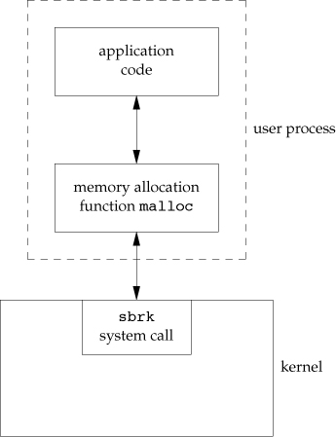
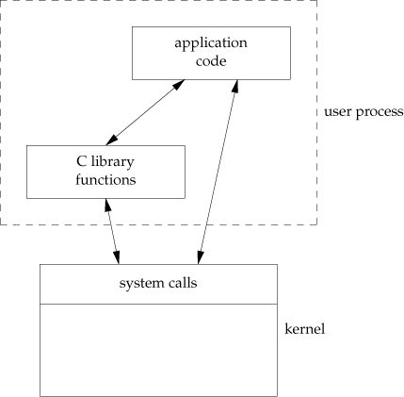
malloc() and sbrk()
malloc(): standard C library function
sbrk(): system call

Slide 23
Why System Calls Look Like Function Calls?
System call is a C function call, but hidden inside that function call is the trap instruction. More specifically, when you call open() (for instance), you are executing a function call into the C library. Therein, whether for open() or any of the other system calls provided, the library uses an agreed-upon calling convention with the kernel to put the arguments to open() in well-known locations (e.g., on the stack, or in specific registers), puts the system-call number into a well-known location as well (again, onto the stack or a register), and then executes the aforementioned trap instruction. The code in the library after the trap unpacks return values and returns control to the program that issued the system call. Thus, the parts of the C library that make system calls are hand-coded in assembly, as they need to carefully follow convention in order to process arguments and return values correctly, as well as execute the hardware-specific trap instruction. And now you know why you personally don’t have to write assembly code to trap into an OS; somebody has already written that assembly for you.

